Slide 1
Telecommunicator hiring process
Public Safety Assistant Manager
Angela Brown
AngelaBrown@yakimawa.gov
509-575-6058
Suncomm - 911 Communications (yakima911.org)

Slide 2
Application process
Typing Test: Suncomm & The City of Yakima require 30 WPM
MAKE SURE YOU COMPLETE THE 5 MIN TEST & ATTACH IT!!!
Practice websites:
Free Typing Test - Typing Speed Tests - Learn Your WPM - Typing.com
Free Online Typing Test - Results in 60 seconds! (speedtypingonline.com)
Following your initial application, you will be contacted by HR and scheduled to take a test called Criticall.

Slide 3
CritiCall
The Criticall test, also referred to as the dispatcher skills test, is a computer-based assessment that is given to applicants to make sure they have the qualities needed to be a Telecommunicator. The test is broken down into various sections that target specific skills required on the job.
The point of this exam is to create a high stress situation where you are expected to think fast, remember information, and make quick decisions. These are skills that can be learned through practice.

Slide 4
What to expect
There will be various types of questions that will test how successful you will be as a dispatcher. The 3 main test categories are:
Data Entry
Dispatcher Skills
Memory & Comprehension

Slide 5
Data Entry
Data Entry - The focus on these questions is to test your ability to make quick decisions, prioritize and multitask. You will be given information through both audio and written formats and you will need to input data into the correct tables.
Cross Referencing - You will be required to enter identifying information from address books into a corresponding table.
Character Comparison - You will be given two tables which look very similar and be required to identify the differences.

Slide 6
Dispatcher Skills
Decision making - As a dispatcher you are the first line of defense and you need to know which emergency service to dispatch. Be prepared to listen to potential situations and pick a course of action.
Prioritization - You will need to rank a few incoming calls according to urgency.
Probability - It is often difficult to hear exactly what the emergency caller is saying. So you will be given questions asking you to decipher unclear calls based on how probable the situation potentially is.
Map Reading - As a dispatcher you must have a strong understanding of your area and know how to read maps well so you can send the correct emergency unit to the scene. In this question you will need to choose the best route while obeying traffic laws for the emergency vehicle to get to the scene the quickest.

Slide 7
Memory and Comprehension
Summarization - You will be required to listen to an audio call simulation answer questions related to the call and summarize the data. Be prepared to input identifying information into proper data fields.
Reading Comprehension - You will also be presented with information in a written format and be expected to answer questions or choose the best summary of information.
Memory Recall - You will be presented with visual and audio information including sets of numbers, phrases, and letters and be asked to recall the information. A huge part of being a dispatcher is being able to recall information presented to you. You will also be given scenarios where you will be required to keep track of all responding emergency units, including how many and the number of people at the emergency.

Slide 8
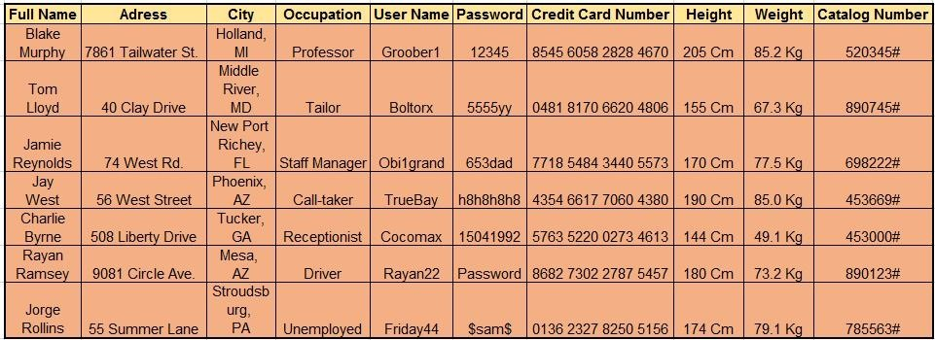
Example Test Questions
Credit: JobTestPrep
Fill in the name of the second person in the table?
Who lives at 56 West Street?
What is the catalog number of the only person from Florida?

Slide 9
Dispatcher Skills: Determining Urgency
In this type of question you will get a simulation of a call you would receive as a 911 operator. As the 911 operator you are responsible for determining and categorizing calls from least to most urgent.
Here is a rubric of how you determine the level of urgency of a call:
Situations which involve a loss of life or serious injury
Situations which involve a sexual assault of a serious nature
Situations which involve a property loss of a serious nature
Injuries which do not include an immediate life loss
Situations which include minor property loss
Non-emergency calls which report a crime
Non-emergency calls that don't report a crimes
If you receive multiple calls in the same category always prioritize the situation that can be stopped. Always prioritize a situation where the suspect is unknown.

Slide 10
Determining Urgency Sample Questions
Which of the following situations is the most urgent?
A mother calling saying her child had a skateboarding accident and injured his hand.
A woman calls saying she is walking in an area without a lot of people and a group of drunk men are stalking her.
A citizen reporting graffiti to her fence that occurred overnight.
A man requesting information regarding assistance with a snake on his porch.
Answer: B A woman calls saying she is walking in an area without a lot of people and a group of drunk men are stalking her.

Slide 11
Comparing and Contrasting Question
ORIGINAL COPY
VM Blvd / Longfibre Rd VM Blvd / Longfibre Rd
Yakima 96,968 Yakima 96,968
Sunnyside 16,742 Sunnyside 17,642
Suspicious Circumstances Suspicious Circumstances
Answer: Sunnyside 16,742 Sunnyside 17,642

Slide 12
Resources
Youtube:
Criticall Test Prep | Critcall Test Prep Guide - YouTube
The Raspy Dispatcher - YouTube
911 Dispatcher - A Day in the Life - YouTube
CritiCall 911 Dispatch Test Example - YouTube

Slide 13
Practice Test Websites
Criticall test (911 Dispatcher) - Free Practice Test & Guide (prepterminal.com)
Applicants » CritiCall 911 Dispatcher & Emergency Calltaker Testing Software
There’s several others if you search “Dispatcher practice test”

Slide 14
What to expect
The hiring process can take up to a few months, don’t get discouraged!
You will be required to take a personality test
This helps us examine your fundamental personality traits, such as conscientiousness, agreeableness and emotional stability.
Upon completion you will have an interview with a panel made up of various user agency representatives
Fire chiefs
Police admin
Other communication center mangers
Suncomm’s Training Supervisor

Slide 15
Almost there
The final step in this process is a polygraph test
Upon successful completion you will receive a tentative job offer!
GOOD LUCK to you all and please contact me if you have any questions.

Slide 16
Informative Websites
Free CritiCall Test Practice & Full Prep [Typing, Maps & More] (jobtestprep.com)
Free CritiCall Practice Test & More – iPrep
CritiCall Practice Test Questions (test-preparation.ca)
National 911 Program | 911.gov
How to Become a 911 Operator | How to Become a 911 Dispatcher (911dispatcheredu.org)
911 Emergency Dispatch
APCO International - Leaders in Public Safety Communications (apcointl.org)
National Emergency Number Association (nena.org)

